Slide 1
What is Python
Python is compiled as well as interpreted programming language invented by Guido van Rossum , a Dutch scientist in 1989. It is also an open source programming language.

Slide 2
Python Version History
First released on 20th Feb 1991 ( version 0.9.0)
1.0 Jan 94
2.0 Oct 2000
3.0 Dec 2008
2.7 July 2010
3.6.5 28th March 2018
3.7 27th June 2018
3.8.0 14th Oct 2019
....
......
current latest ( as of now ) 3.10 launched on 6th Dec 2021

Slide 3
Python
Python - is a language which has got its set of rules and syntaxes.
But we can never download Python in our computers. We all download Python compilers and interpreters which is available in Python implementations.

Slide 4
Python implementation
Python implementation means tools which you need to work in Python and the tools are
a) Python Compiler
b) Python Interpreter
That means
Python implementation = "Python compiler + Python interpreter"

Slide 5
Various Python implementations
Python implementation = "Python compiler + Python interpreter«
Following are some of the implementations of Python:
Cpython
The default implementation of the Python programming language is Cpython. As the name suggests Cpython is written in C language. Cpython compiles the python source code into intermediate bytecode, which is executed by the Cpython virtual machine.

Slide 6
Various Python implementations
Jython
Jython is an implementation of the Python programming language that can run on the Java platform.Jython compiles into Java byte code, which can then be run by Java virtual machine.
IronPython
A Python implementation written in C# targeting Microsoft’s .NET framework. Similar to Jython, it uses .Net Virtual Machine i.e Common Language Runtime.
PyPy
PyPy is an implementation of the Python programming language written in Python.
“If you want your code to run faster, you should probably just use PyPy.”

Slide 7
Interpreted or compiled?
Python is considered as both compiled as well as interpreted language, as it involves a compilation step that converts the python code into bytecode which is stored with a .pyc extension that gets deleted once the program is executed. Bytecode is also binary representation executed by virtual machine (not by CPU directly). The virtual machine (which is written different for different machines) converts binary instruction into a specific machine instruction.

Slide 8
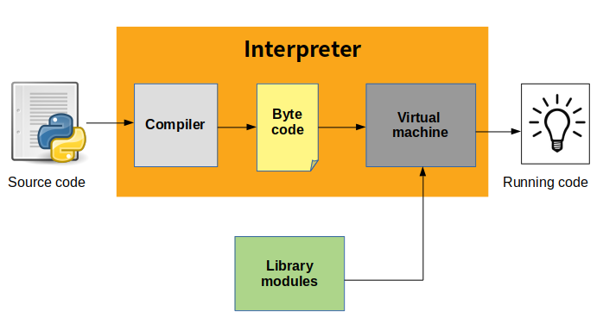
Interpreted or compiled?

Slide 9
First.py [ Source code ]
compile
What if we would like to run this code on other platforms?
First.pyc [ byte code ]
run
PVM
interpreter
Memory manager
Windows

Slide 10
Compile once, run anywhere [ on any platform ]
First.pyc [ byte code ]
run
PVM
Memory manager
Interpreter
Linux

Slide 11
Compile once , run anywhere [ on any platform ]
First.pyc [ byte code ]
run
PVM
Memory manager
Interpreter
Macintosh

Slide 12
Various applications of Python
Artificial Intelligence and Machine Learning
It is heavily used in Face recognition, music recommendation on youtobe,medical data,Driverless Cars,Google's Speech Recognition etc.
Some of the popular web sites are designed in Python are:
NASA,Instagram,Udemy,Spotify,Mozilla,Dropbox
Youtube
The major part of youtube has been developed in Python.
Hacking
"Hackers" generally develop "small scripts" and Python provides "amazing performance" for small programs.

Slide 13
Various applications of Python
Data Science
you collect data from the business
with the help of that data you decide how will you grow your business in future. Numpy and Pandas are leading libraries of Data Science in Python.
Internet Of Things [IOT]
refers to the "billions of physical devices" around the world that are now connected to the internet, all collecting and sharing data.
e.g. A "lightbulb" or "fan" or "AC" which can be switched on using a "smartphone app" is an IOT device.
There is a company Syska. Whatever products it makes based on IOT.

Slide 14
Features of Python
simple
dynamically typed language
supports both POP and OOP
robust - exceptions
compiled as well as interpreted
Compilation part is hidden from the programmer , so mostly people say that it is an "interpreted langauage" which is not correct.
6. cross platform language
7. Extensible
Python allows us to call C/C++/Java/Dot Net code from a Python code and thus we say it is an "Extensible" language.
8. Huge library
it can help you do various things like "Database Programming","E-mailing","GUI Programming" etc.

Slide 15
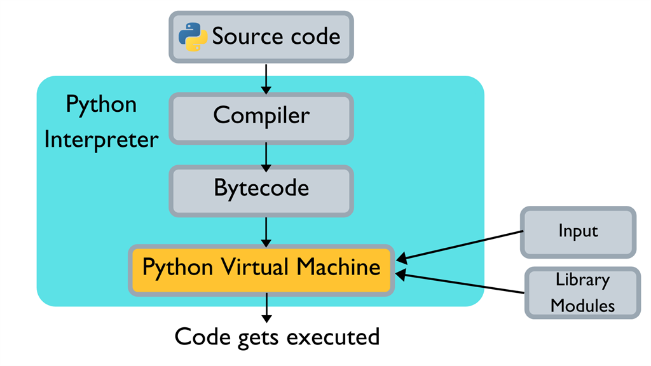
How does Python work?

